Slide 1
THE NEXT PHASE OF AI IN EDUCATION
Student-Centered AI Engagement

Slide 2
THE SHIFT IN AI
AI is transforming education across all levels
Current focus: content creation and instructional support
Next phase: student engagement and learning outcomes

Slide 3
THE CURRENT GAP
Faculty tools are advancing rapidly
Students still lack structured, real-time support
Isolation, inconsistency, and misuse of AI persist

Slide 4
THE OPPORTUNITY
Introduce a student-facing AI layer: LearnAssist™
Bridge content and comprehension
Support guided, interactive learning

Slide 5
THE SOLUTION
AI Academic Companion Avatar
Research-informed and faculty-aligned
Designed to support engagement and critical thinking

Slide 6
HOW IT WORKS
Voice, text, and multimodal interaction
140+ languages supported
Session summaries and micro-lessons
Real-time guided feedback

Slide 7
FACULTY-CENTERED DESIGN
Faculty control all content
Avatar reflects instructor voice and expectations
Extends, not replaces, teaching presence

Slide 8
STUDENT IMPACT
Reduces isolation
Builds confidence and self-efficacy
Develops higher-order thinking skills
Promotes ethical AI use

Slide 9
AI SUPPORT + AVATAR = COMPLETE ECOSYSTEM
Current AI Support
  Faculty tools
  Content creation
  Course design
  Instructional support
AI Avatar
  Student interaction
  Guided learning
  Engagement + retention

Slide 10
WHY THIS MATTERS
Improves retention and outcomes
Supports AI policy and integrity
Prepares students for AI-driven careers

Slide 11
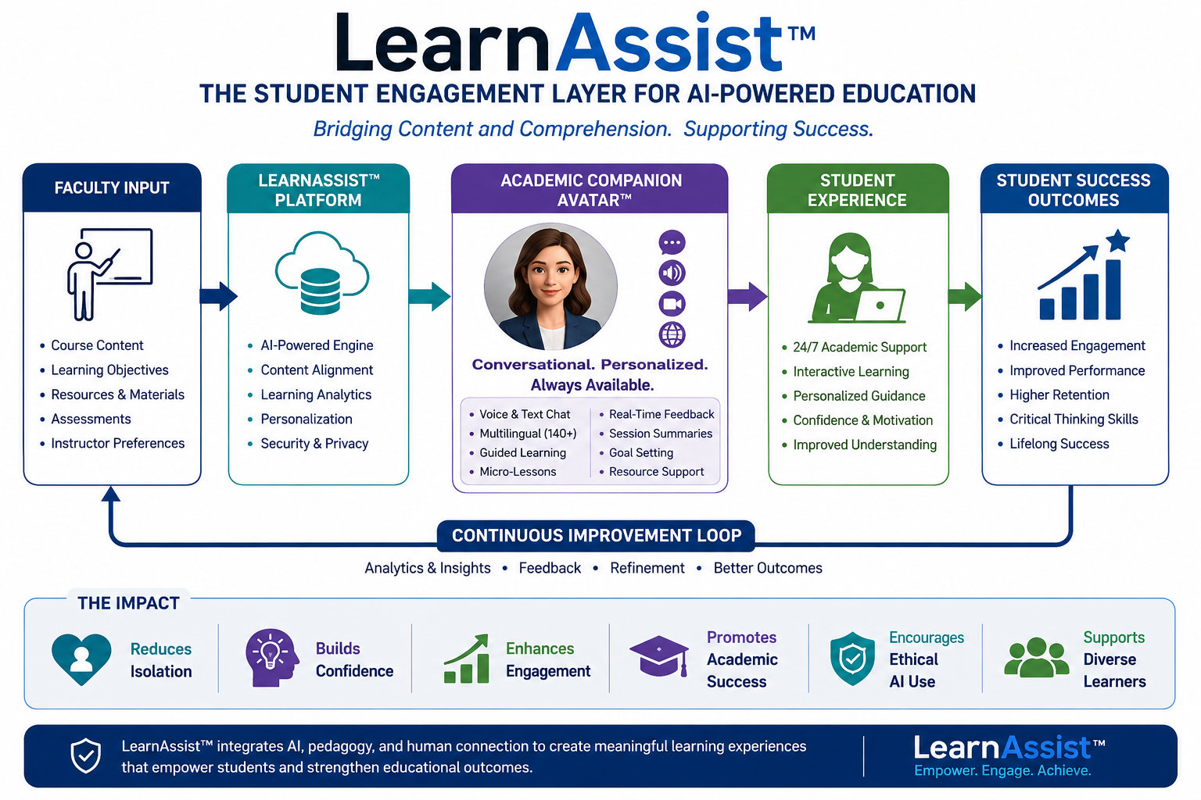

Slide 12
STUDENT EXPERIENCE: BEFORE VS AFTER
Before
  Limited access to support
  Feelings of isolation
  Unstructured AI use
  Low confidence in learning
  Inconsistent feedback
After
  24/7 guided academic support
  Increased engagement and connection
  Structured, ethical AI interaction
  Improved confidence and self-efficacy
  Consistent, faculty-aligned feedback

Slide 13
KATHLEEN COVEY, Ed.D.
Founder
LEARNASSIST™ and AI Academic Companion Avatar
MAXIMILIAN COVEY, CEO
Dissertation Complete, LLC

